Slide 1
BIOE 498 / BIOE 599: Computational Systems Biology for Medical Applications CSE 599V: Advancing Biomedical Models Lecture 2: Modeling Essentials
Joseph L. Hellerstein*
Herbert Sauro**
*eScience Institute, Computer Science & Engineering
**BioEngineering

Slide 2
G.P.E. Box (Famous Statistician)
All models are wrong.
But some models are useful.

Slide 3
Agenda
Conceptual models
Variable types, units, relationships
Dimensional analysis
Deterministic time course models
Stochastic time course models

Slide 4
Refresher
What are we modeling?

Slide 5
Running Example: Hydraulic Engineering
Streams fill lake
Flow rate
Lake provides recreation
Water level
Flow rate
Streams fill reservoir
Flow rate
Pipe provides lake water to reservoir
Flow rate
Reservoir provides public water
Water level
Flow rate

Slide 6
The Problem
_{Lake height}
_{Reservoir height}
Maximize the height of the lake water subject to a minimum height of the reservoir water.
Most recreational benefit to public
Ensure delivery of quality water to public

Slide 7

Element
Abstraction of a system component as a collection of related variables.
Variables
Units
rivers
Flow:
out = flow out
m³s⁻¹ = cubic meters per sec
lake
dam
m³s⁻¹
in = flow in
Vessel:
out = flow out
m³s⁻¹
height = water height
m = meters
pipe
Conduit:
in = flow in
m³s⁻¹
out = flow out
m³s⁻¹
setting = valve position
$∅$ = unitless

Slide 8
A conceptual model relates inputs to outputs.
Variables
Conceptual
Model
Flow:
out
in
Vessel:
out
unknown
function
height
Conduit:
in
unknown
function
out
setting

Slide 9
Conceptual Model
F1
V1
F2
A conceptual model specifies how the inputs of one element relate to the outputs of other elements.
P
V2
F1.out
=
+
F2.out
=
P.in
P.setting
V2.in
V1.in
V2.height
V1.height
P.out
V2.out
V1.out
Modeling objective
Given F1.out, F2.out
Find V1.height, V2.height

Slide 10
The Vessel Black Box
Vessel.in
Vessel.height
Vessel.out
How do we compute Vessel.height from Vessel.in and Vessel.out?
Modeling assumption
Vessel is a cylinder with radius Vessel.radius, a model parameter
How is Vessel.radius estimated?
Notes:
A lake is not a cylinder. The model is wrong. But this can be a useful approximation.

Slide 11
Technical Model for Vessel.height
Vessel.volume = Vessel.height*Pi*Vessel.radius²
dVessel.Volume = Vessel.out – Vessel.in
dVessel.height = (Vessel.out – Vessel.in)/(Pi*Vessel.radius²)
Integrate (sum) to calculate Vessel.height from dVessel.height.

Slide 12
Simplified Modeling Workflow
System Diagram
Conceptual
Model
F1.out
=
+
F2.out
=
P.in
P.setting
V2.in
V1.in
V2.height
V1.height
P.out
V2.out
V1.out
Technical
Model
dVessel.height = (Vessel.out – Vessel.in)/(Pi*Vessel.radius²)

Slide 13
Vessel, Flow -> Species, Reactions
Relate to reactions
Show units
Conceptual model relates to metabolism
But box is for enzyme, not function

Slide 14
Dimensional Analysis

Slide 15
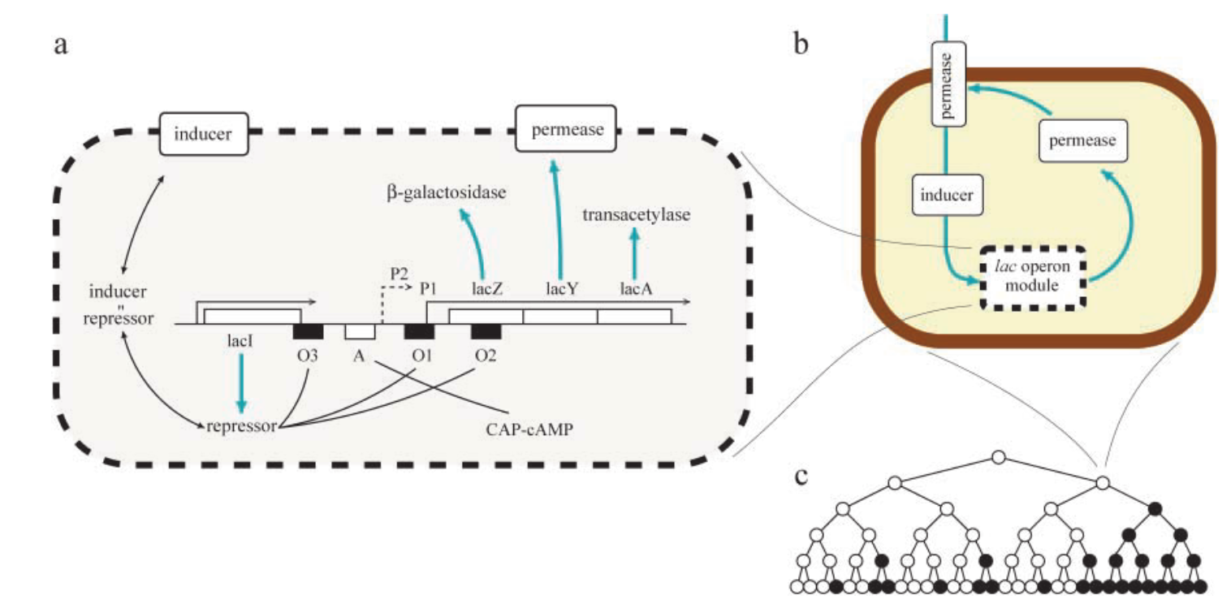
Lac Operon*
*Vilar et al., 2003. Journal of Cell Biology.

Slide 16
Technical Models With Differentials

Slide 17
Technical Models With Stochastics

Slide 18
Learning Objectives
Conceptual models
Construct appropriate element abstractions of a system, their variables, and the relationships between variables

